Slide 1



KONGU ENGINEERING COLLEGE
PERUNDURAI ERODE-638060
Department of Computer Science and Engineering
20CSP61-PROJECT WORK I
Website for RESTAURANT MANAGEMENT
PRESENTED BY :
PROJECT GUIDE:
Dr. M. GEETHA
Associate Professor , CSE
THEEBASEHARAN M S - 21CSR230
VIKNESHVARAN S U - 21CSR240
THULASIRAJAN - 21CSR232

Slide 2
COMPANY DETAILS
Owner:Saravanan S
Company name:Selvi’s Asaiva Virundhu Restaurant
Address:2/240,Opposite to Nandha Nursing College, Erode to Perundurai Main Road, Koorapalayam, Vaikalmedu-638052
Contact:9486167510
Date approached:09/03/2024

Slide 3
PROBLEM STATEMENT
The restaurant is currently performing good and in the vision of scaling their restaurant business, the Stakeholders are in need of a website to meet their Scalability needs in their constantly expanding business.
In the restaurant business , there is a need to establish trust and authority among the customers. Having a website will aid in Building Authority for their Business.
To further improve their branding strategies and to give them an unfair advantage over their competitors.

Slide 4
PROPOSED WORK
To create a highly interacting user friendly website to strongly establish their Brand.
To provide with a support plan to constantly monitor their customers’ interaction and provide additional support to their customers’ likeness.
To ensure credibility of the customers by directly interacting with their audience without any third-party involvement .

Slide 5
SOFTWARE REQUIREMENT SPECIFICATION
1. INTRODUCTION
1.1 PURPOSE
The purpose of the website is to establish a web-based solution that empowers administrators to efficiently showcase their business.
A good and attractive website for captivating individuals.
Allow public to communicate through the website for the clarification and further information.
1.2 INTENDED AUDIENCE
Admin : Has control of the entire website.
Public : Has access to view the website.

Slide 6
SOFTWARE REQUIREMENT SPECIFICATION
SCOPE
User-friendly interface for easy navigation and interaction.
Compatibility with various devices for optimal accessibility.
REFERENCE
https://saravanabhavan.co/
https://aabsweets.com/

Slide 7
SOFTWARE REQUIREMENT SPECIFICATION
OVERALL DESCRIPTION
PRODUCT PERSPECTIVE
User-friendly platform for customers to explore the design thinking.
Provides detailed information about each phases.
INTENDED AUDIENCE AND READING SUGGESTIONS
Home
About Us
AI chat bot
Blog
Contact

Slide 8
SOFTWARE REQUIREMENT SPECIFICATION
2.3 OPERATING ENVIRONMENT
Web Browsers: Chrome, Firefox, Safari, and Edge.
Operating Systems: Windows, macOS, iOS, and Android.
Internet Connectivity: Requires reliable internet
Responsive Design: Adapts to different screen sizes on desktops, laptops, tablets, and smartphones.
2.4 ASSUMPTIONS AND DEPENDENCIES
Users should have reliable internet access and compatible devices.
To make the users engaged with the website’s captivating content.
Information provided on the website is accurate.

Slide 9
SOFTWARE REQUIREMENT SPECIFICATION
SYSTEM FEATURES
FUNCTIONAL REQUIREMENTS
Provide a welcome message and imagery.
Enable easy navigation to other sections.
Share information about the necessity of design thinking.
Providing notifications for an update.

Slide 10
SOFTWARE REQUIREMENT SPECIFICATION
NON FUNCTIONAL REQUIREMENTS
1. PERFORMANCE METRICS
Reliability : 24/7 availability, regular backups
Performance : Fast loading times, capable of handling high traffic.

Slide 11
MODULE DESCRIPTION
HOME
PRODUCT CATALOG
CART
ORDER
PAYMENT

Slide 12
SOFTWARE TOOLS USED
FRONT END:
HTML, CSS, Bootstrap, ReactJS
BACK END:
Node JS
Database:
Mongo DB
Version control system:
Git

Slide 13
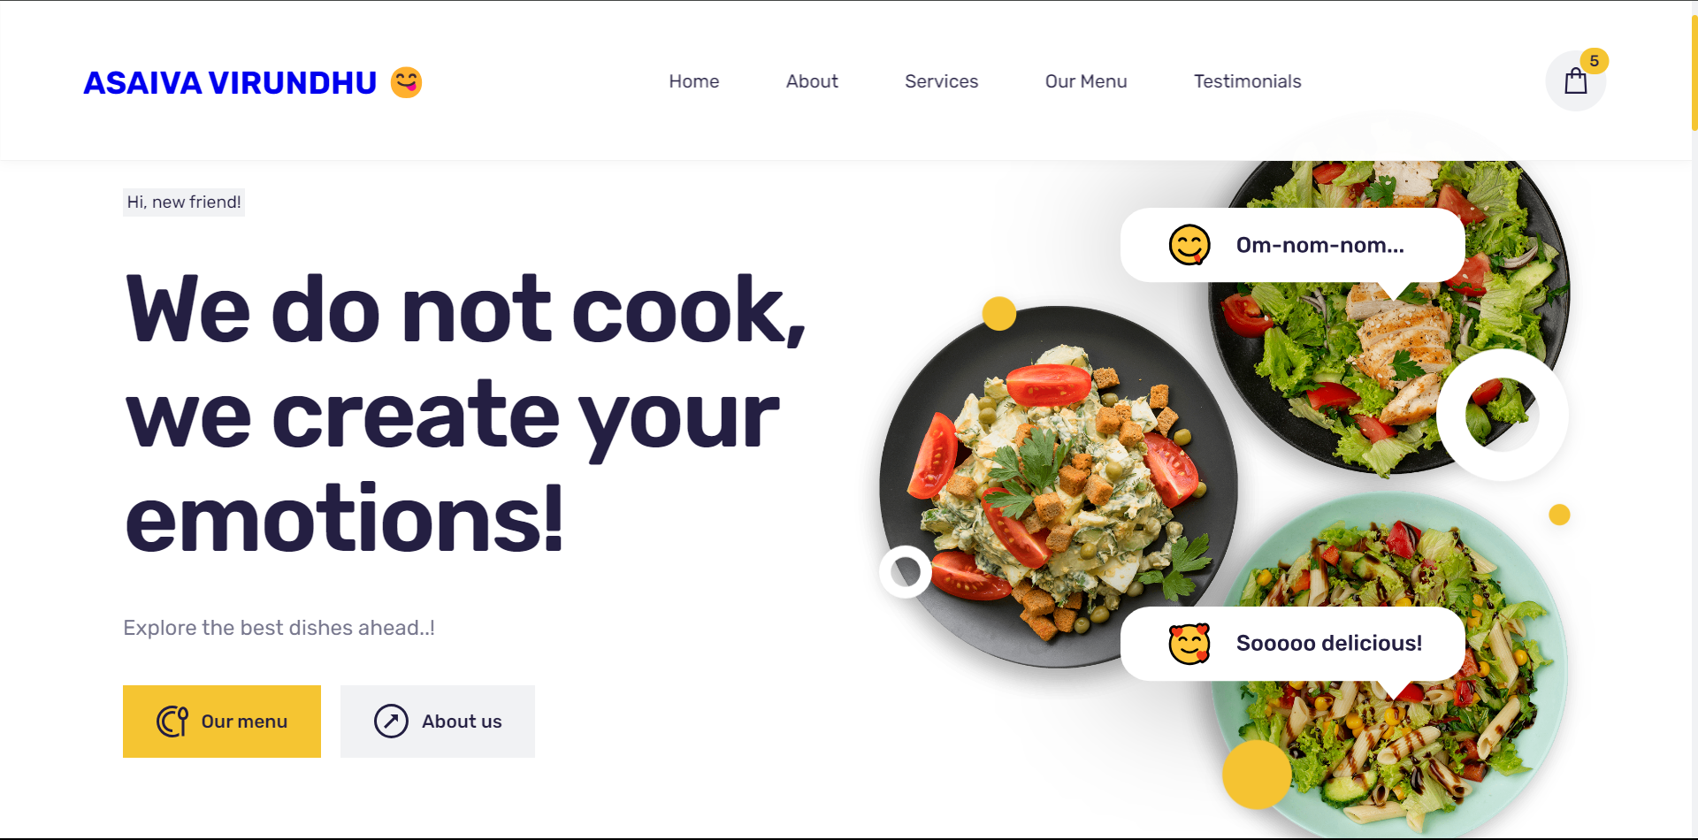
IMPLEMENTATION

Slide 14
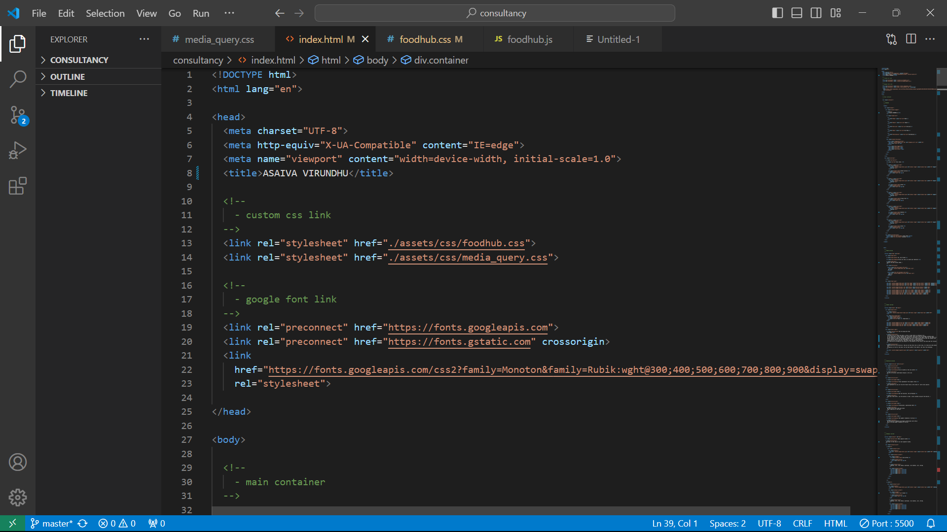
IMPLEMENTATION

Slide 15
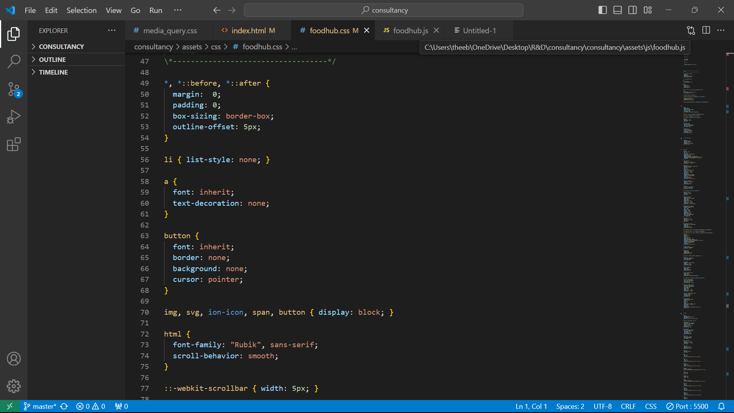
IMPLEMENTATION

Slide 16
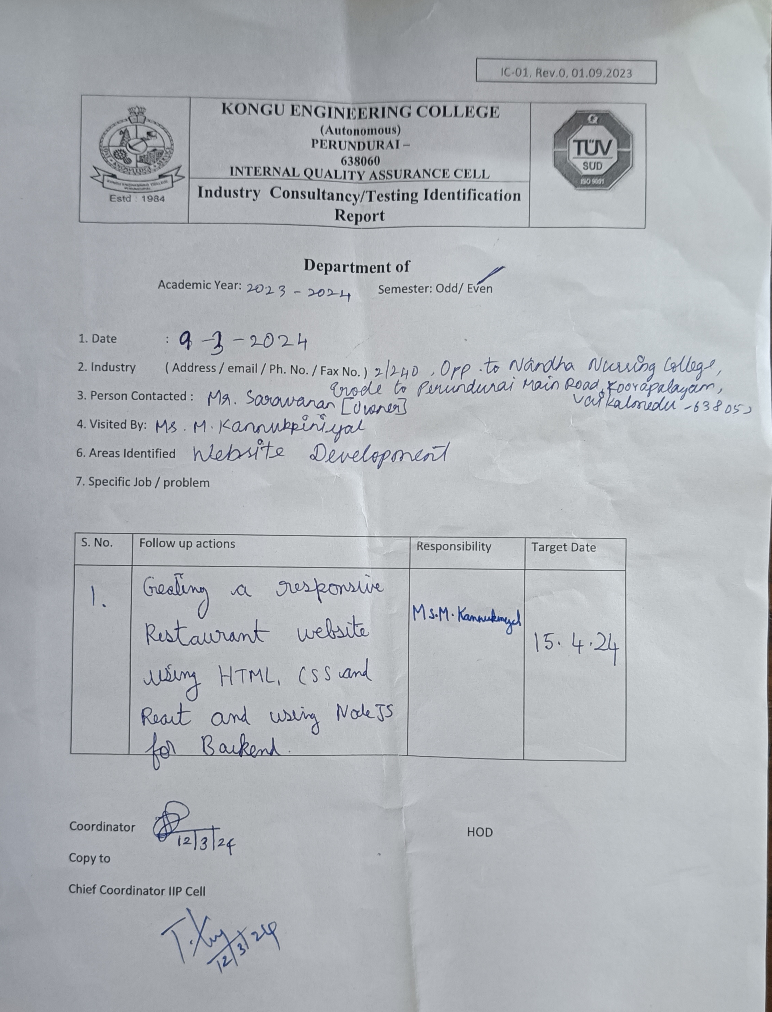
IC01 DOCUMENT

Slide 17
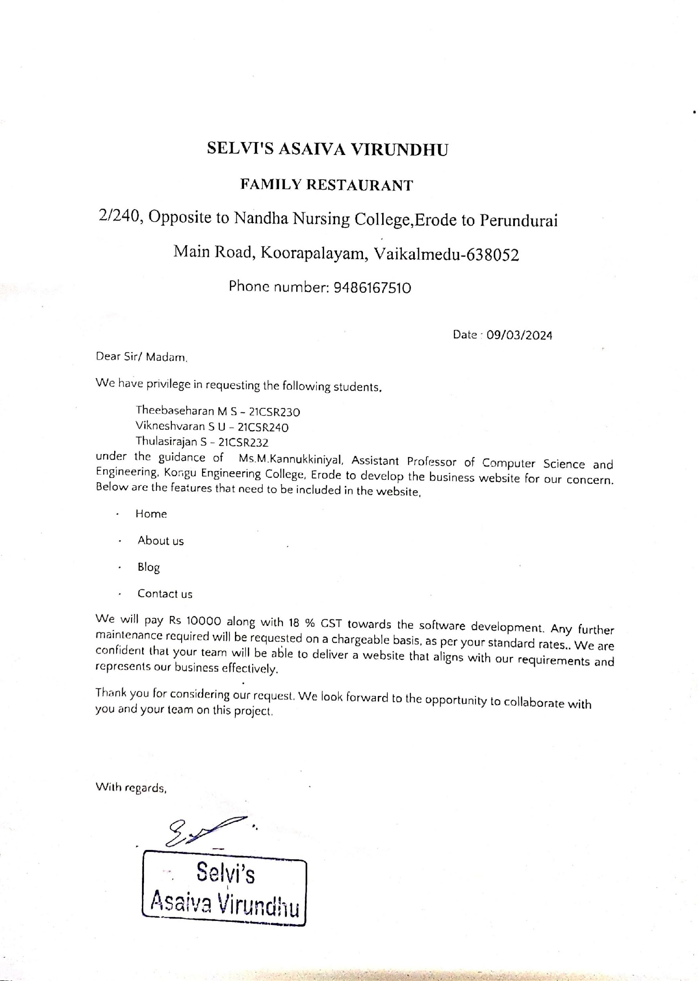
REQUISITION LETTER FROM COMPANY

Slide 18



